Slide 1
Parrylands Heavy Oil Field, Block E, Trinidad
Huff n’ Puff
5-spot on 2.5 acre spacing
Pure Steam vs Steam + CO₂
Prepared by Amanda M.M. Bustin, Ph.D., P.Eng. 3/8/2023

Slide 2

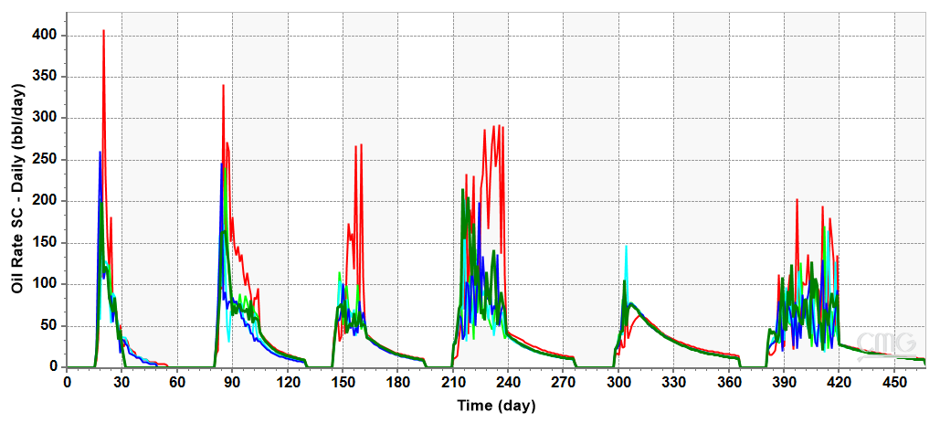
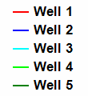
Steam
Production Rate per well
Notes:
section is one square mile
259 hectaers

Slide 3
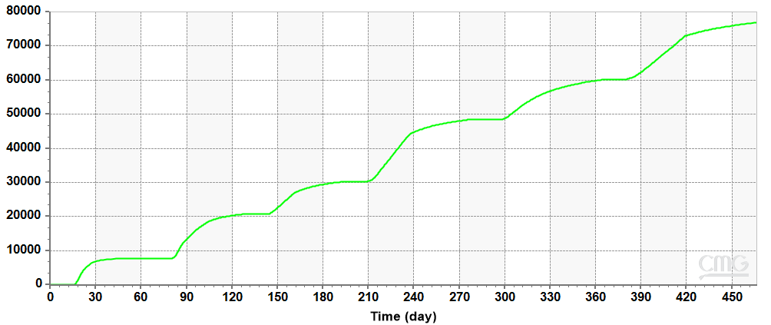

Steam
Total Cumulative Production for all wells
Notes:
section is one square mile
259 hectaers

Slide 4
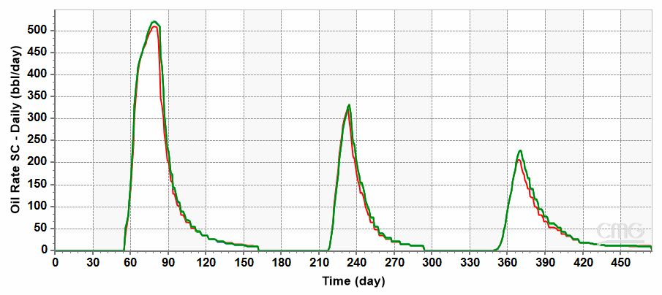
Steam + CO₂
Production Rate per well
Notes:
section is one square mile
259 hectaers

Slide 5
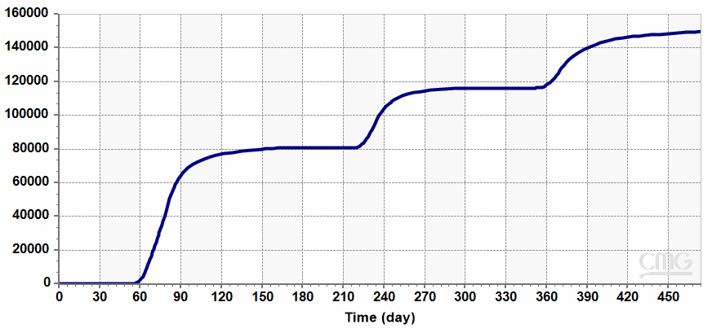
Steam + CO₂
Total Cumulative Production for all wells
Notes:
section is one square mile
259 hectaers

